Slide 1
Information Technology Committee
Chair: Sharon F. Contact: webservant@adultchildren.org
Committee Volunteers: Cheryl F., Mary Jo L., and Michelle H.
Meetings: “Website Weekly Wednesdays” at 1pm Eastern US

Slide 2
Status of Last Year’s Stated Goals:
Ongoing — Sites still under review — we updated some content, fixed broken links and did some SEO enhancements
Completed - Migrated to new email platform
Completed - We do have printable PDFs for Meeting lists
Completed - Enhanced Meeting Map support
On hold - Smartphone app for Meeting Lists and Literature
Ongoing - Review and Maintain Privacy Policies
Ongoing - Enhance Intergroup and Region pages
Ongoing - Meeting updates and verification
Almost LIVE - time zone issues for Meeting Listings

Slide 3
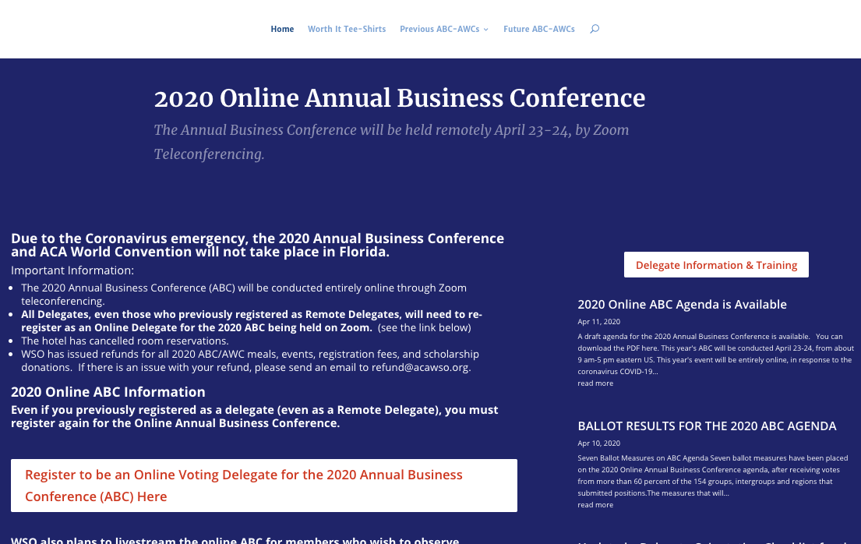
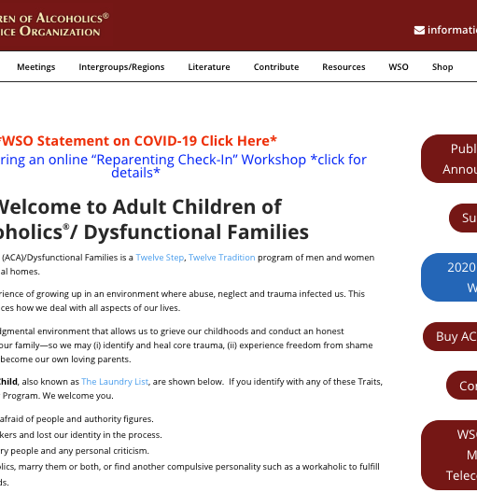
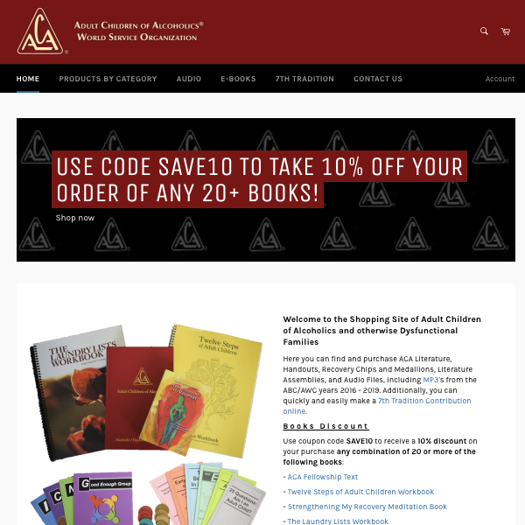
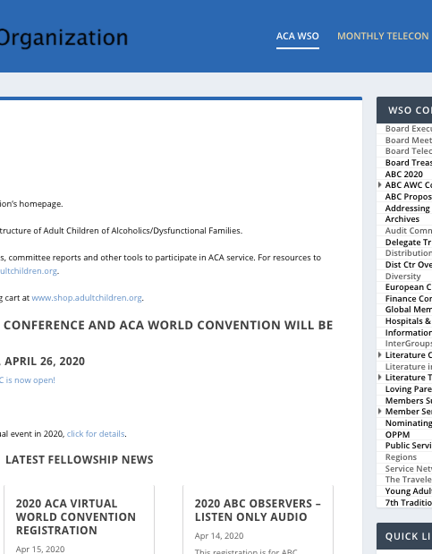
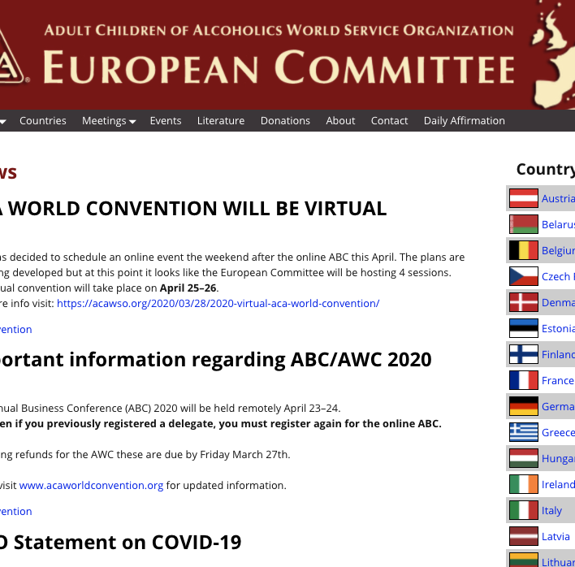
There are Five ACA WSO Websites (addresses and purposes are listed in report)

Slide 4
Other than maintain websites, what does the IT Committee do?

Slide 5
The short answer – We assist all the other committees in the work that they do.
Meeting list database functionality (search, listings, display, etc.)
Assist committees with website content and report postings
Develop online forms for volunteers, contacts, event postings, etc
MailChimp support for The Traveler and The Daily Meditation emails
WSO emails and online storage
Facilitate the WSO Zoom accounts that host committee meetings, workshops, etc.
Provide the technical support for the ABC/AWC
Software and other technology support for Trustees, Committees and Special Workers

Slide 6
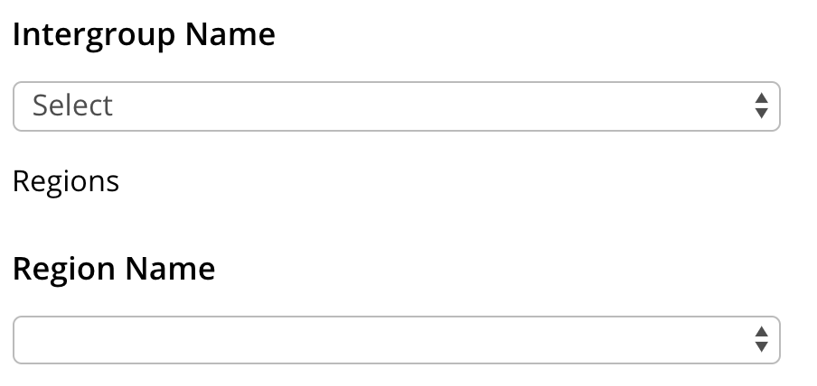
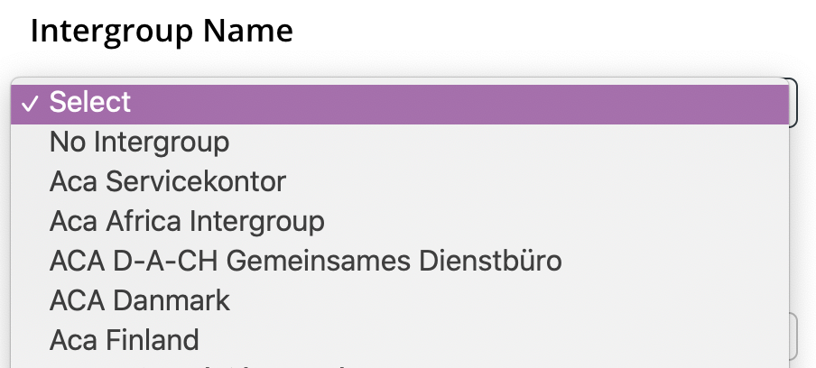
Did you know??
Groups can update their information to affiliate with an Intergroup or Region

Slide 7
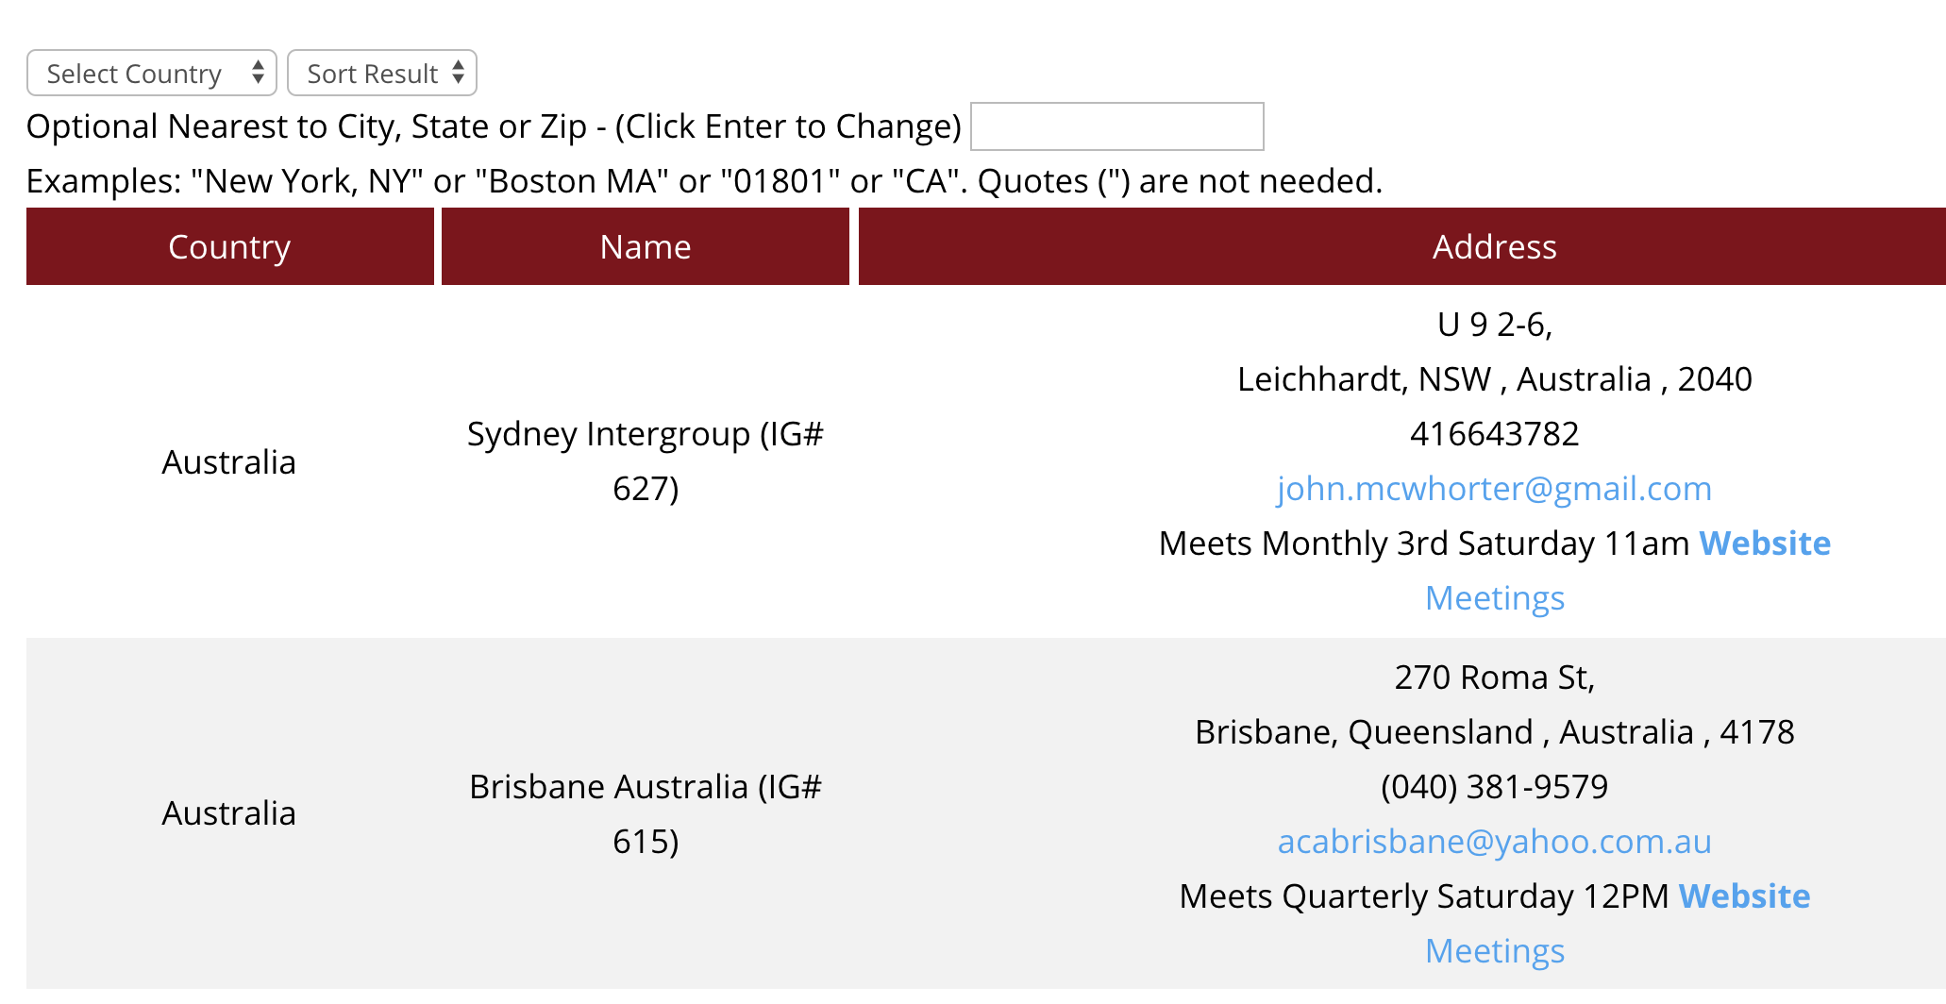
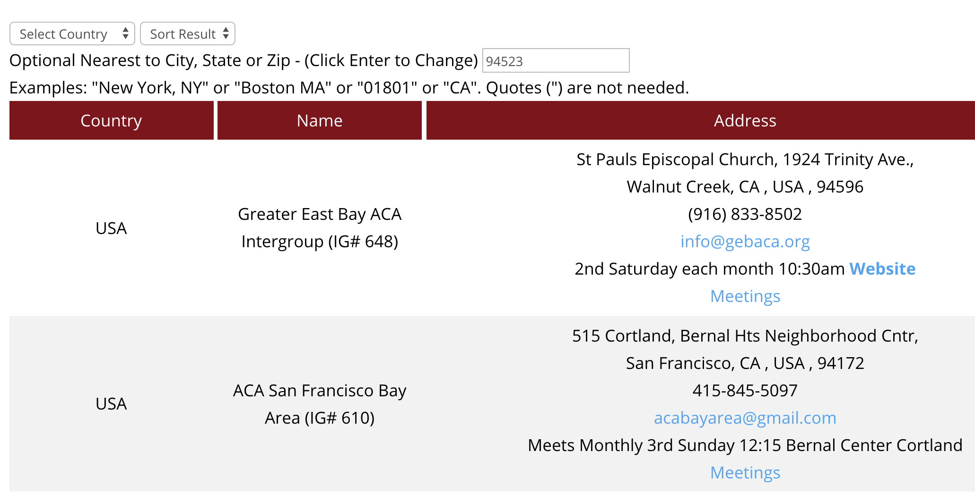
Did you know??
You can find nearby Intergroups by doing a zip code search.

Slide 8



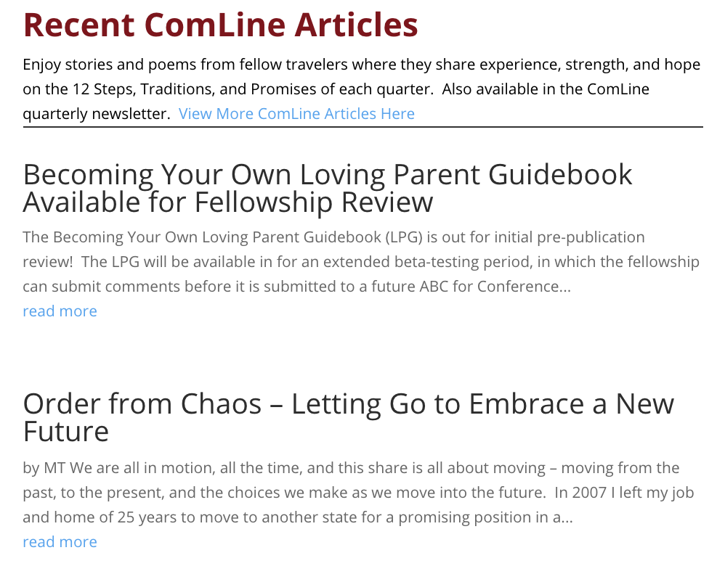
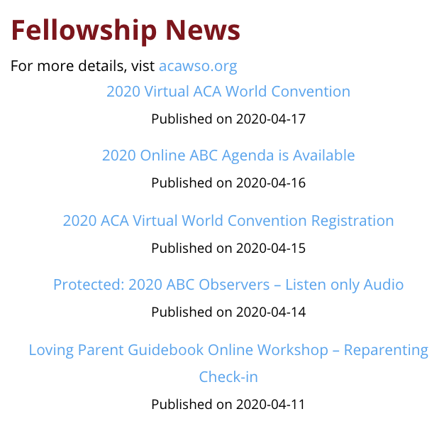
More Mobile-Friendly Features Coming Soon to AdultChildren.org

Slide 9
Do I HAVE to be a programmer or webmaster to serve on the IT Committee?

Slide 10
Short answer is NO! We also need:
Content editors to update existing pages
Zoom scheduling (calendar), meeting & webinar options
MailChimp design and/or audience maintenance
Writer for Traveler Articles
Graphics and/or Web Layout
Document creation for procedure and “best practices” manuals
Create screen shots for procedure manuals
Zoho Forms integrations
Project timeline and task coordination with project management software
Spreadsheet
Anyone else interested
And yes, web developers, PHP programmers, WordPress, and database

Slide 11
If you are interested in finding out more about the IT Committee, send an email to webservant@adultchildren.org or contact Sharon F. on Slack

